Slide 1
Overview

Slide 2
Good Design
Naming | Complexity
Cohesion | Coupling
Notes:
Aspect Guideline Metric Visibility
Naming Names should reflect problem domain None High
Complexity Methods should have a low cyclomatic <10 High
Cohesion Modules should be small and follow the <1KLOC High
single responsibility principle
Coupling Low coupling and dependencies towards None Low
abstractions and interfaces. No cycles.

Slide 3
Lacking Visibility

Slide 4
Fact: Visualization Tools Not Used

Slide 5
As developer

Slide 6
Task: On Boarding

Slide 7
Background: Agile Manifesto
Individuals and interactions over processes and tools
Working software over comprehensive documentation
Customer collaboration over contract negotiation
Responding to change over following a plan

Slide 8
Task: Fix defect

Slide 9
Fact: Info Sys

Slide 10
Task: Implement Feature

Slide 11
Fact: 50%

Slide 12
FACT: Avoid comprehension

Slide 13
Task: Refactor NMI

Slide 14
Need: Understand Dependencies

Slide 15
As architect

Slide 16
Software Rot
Rigidity
Fragility
Immobility
Viscosity

Slide 17
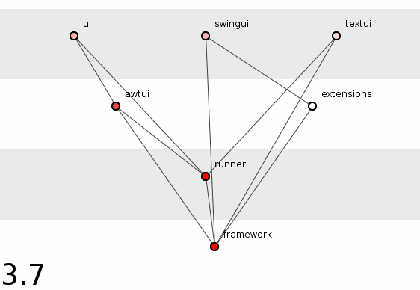

Slide 18
Need: Get feedback on arch

Slide 19
Intentional vs Emergent
Agile architecture balances intentionality and emergence:
Intentional architecture – Defines a set of purposeful, planned architectural strategies and initiatives, which enhance solution design, performance, and usability and provide guidance for inter-team design and implementation synchronization.
Emergent design – Provides the technical basis for a fully evolutionary and incremental implementation approach. This helps developers and designers respond to immediate user needs, allowing the design to evolve as the system is built and deployed.

Slide 20
Intentional vs Emergent: But how

Slide 21
As tester

Slide 22
Need: Integration Strategy

Slide 23
Need: Predict Defects Dep/CC

Slide 24
Fact: More Defects

Slide 25
As manager

Slide 26
Need: Out source

Slide 27
Fact: Lower productiive

Slide 28
Need: Staffing

Slide 29
Lines and Boxes

Slide 30

Notes:
UML is best known lines and boxes notation

Slide 31
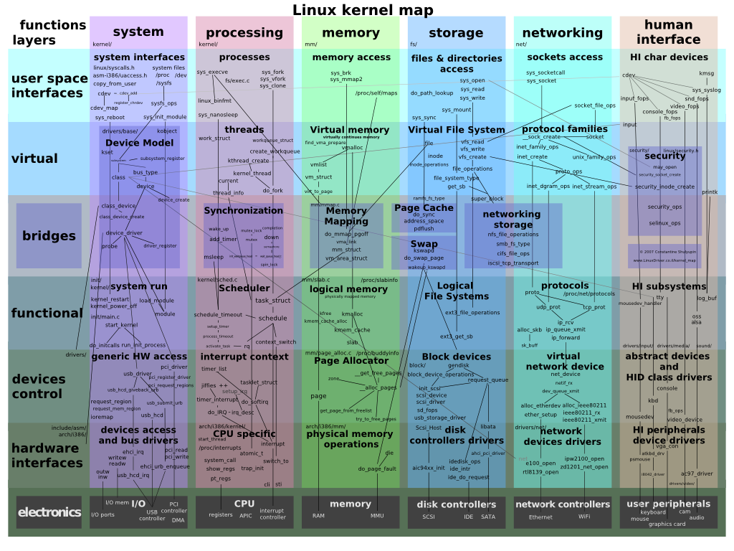
Notes:
But at some point it becomes too cluttered

Slide 32
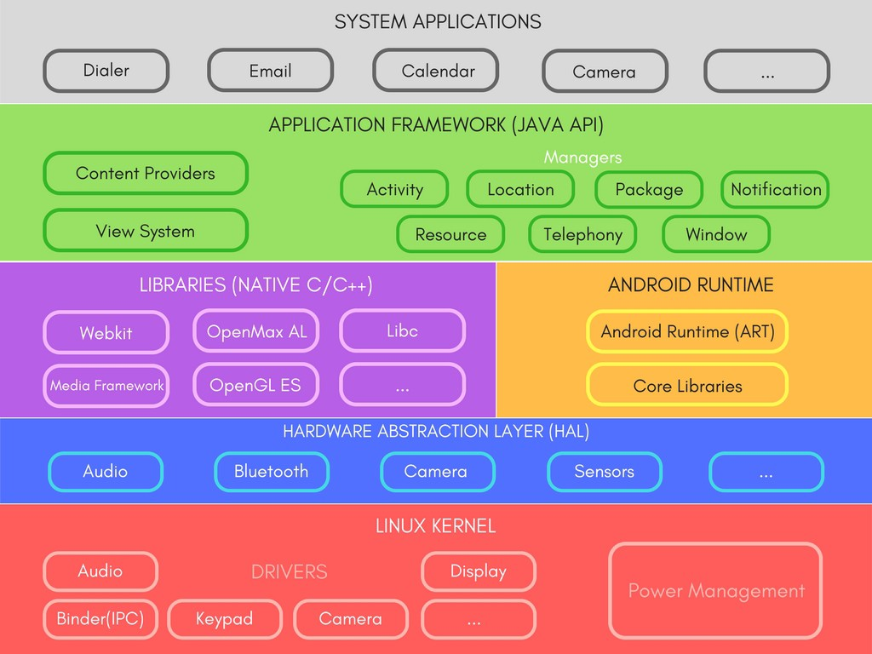
Just Boxes No Lines
Notes:
And then only boxes are shown

Slide 33
Design Structure Matrix

Slide 34
Many dependencies
Wrong direction
Skip layer
Cycle
Not used

Slide 35
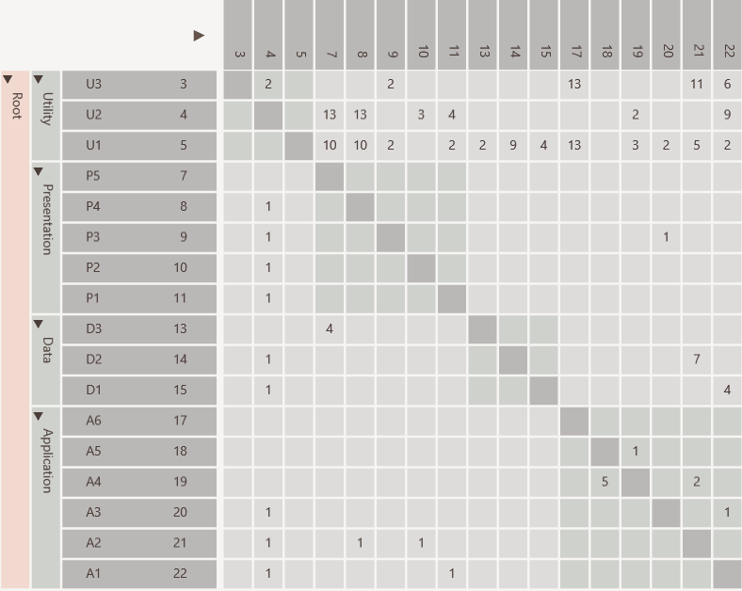
Same rows and columns
Identity line
Value indicates strength
P5 uses D3
Hierarchy

Slide 36
Scalable

Slide 37
Dependencies from A1 to U1, U2 and U3
individually

Slide 38
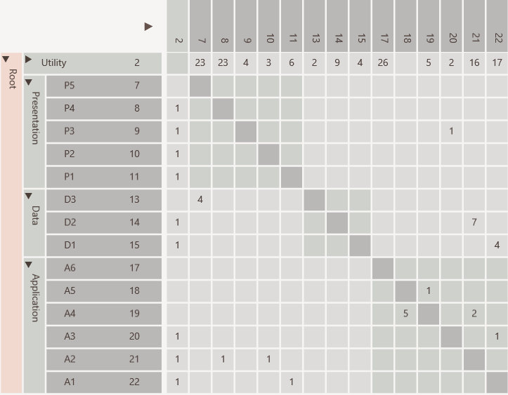
Dependencies from A1 to U1, U2 and U3
aggregated

Slide 39
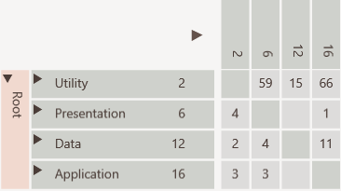
All dependencies between Application and Utility collapsed

Slide 40
Discovery

Slide 41
Many dependencies above identity line

Slide 42
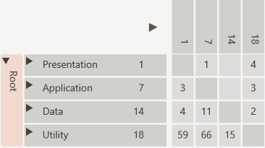
Consumers to top
Cycle easily visible
Providers to bottom

Slide 43
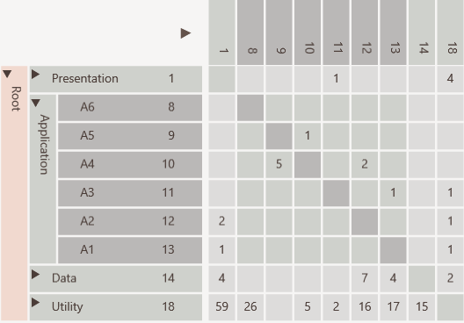
Not used
Encapsulated
Public interface
Encapsulation Pattern

Slide 44
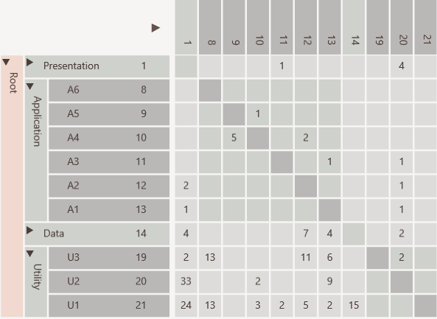
Elements used in entire software like utilities and data access objects
Bus/Utility Pattern

Slide 45
U2 has many in and out going dependencies
Change Propagator Pattern

Slide 46
Refactoring

Slide 47
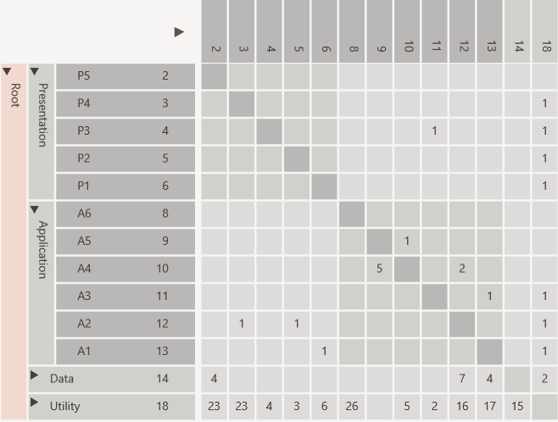
Hierarchical cycle due to
A3 using P3
which violates layering
Before

Slide 48
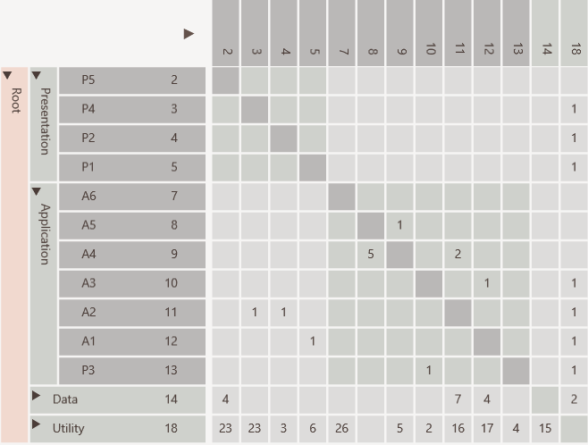
Cycle removed by moving P3
After

Slide 49
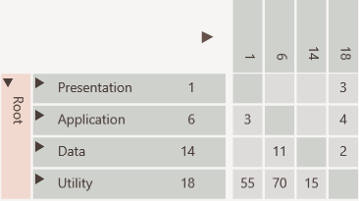

Slide 50
Tools

Slide 51
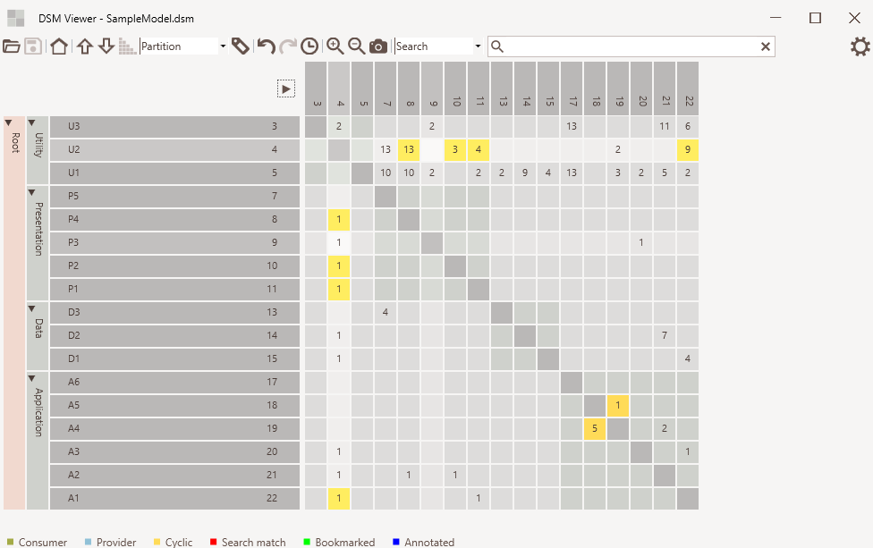
Cell
selected
Element Hierarchy
Cell
hovered

Slide 52
Programming
Language
Checks
Design
Metrics
Dependency
Visualization

Slide 53
DsmSuite

Slide 54
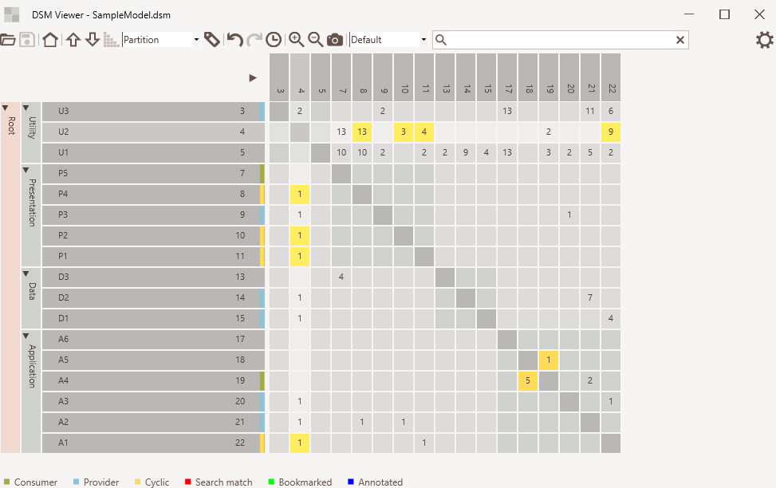
Default mode
Consumer/provider indicators
Normal dependency
Cyclic dependency

Slide 55
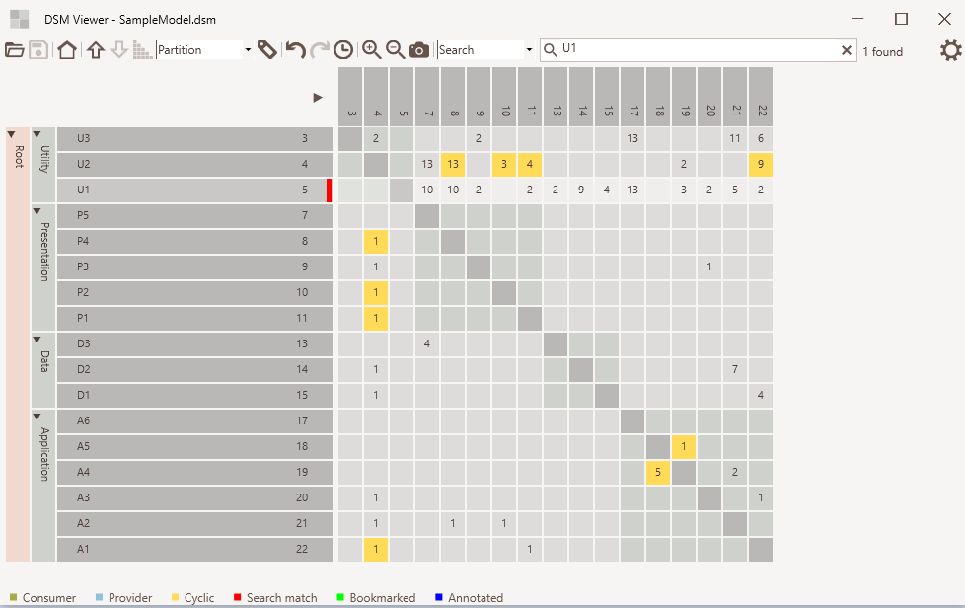
Search mode
Search text
Elements found
Match indicator

Slide 56
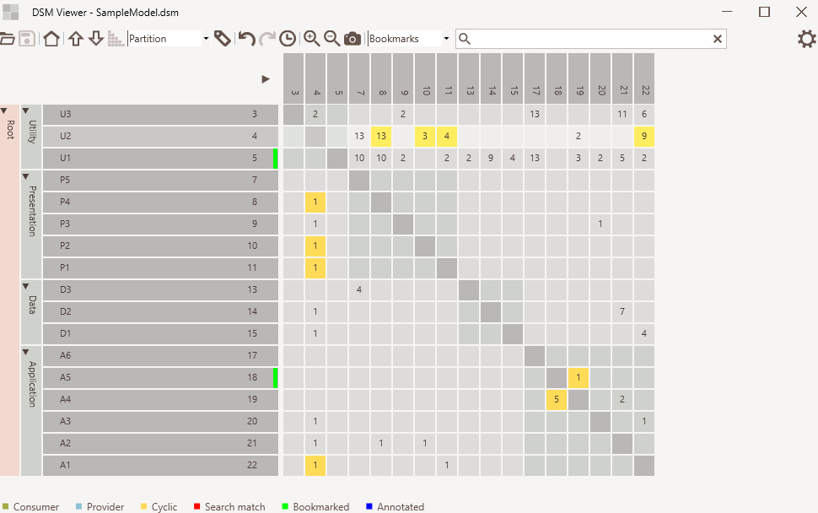
Bookmark mode
Bookmarked
indicator

Slide 57
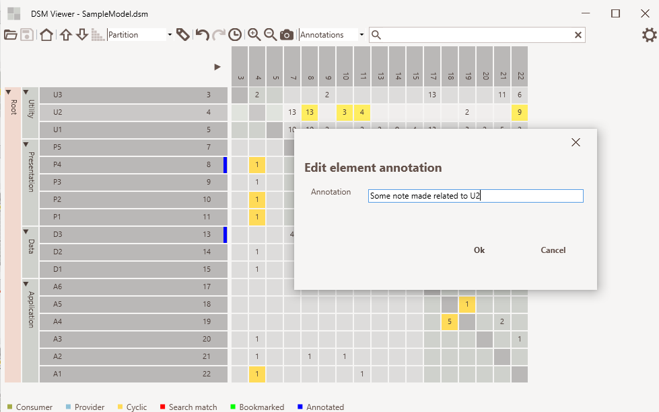
Annotation mode
Annotated
indicator

Slide 58
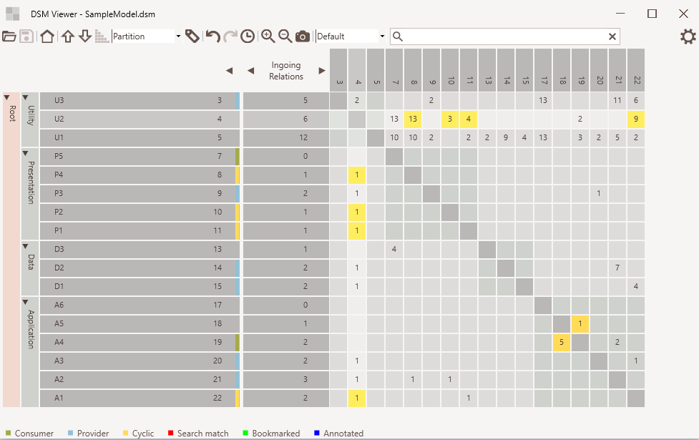
Expand / collapse
Metrics selection
Metrics values

Slide 59
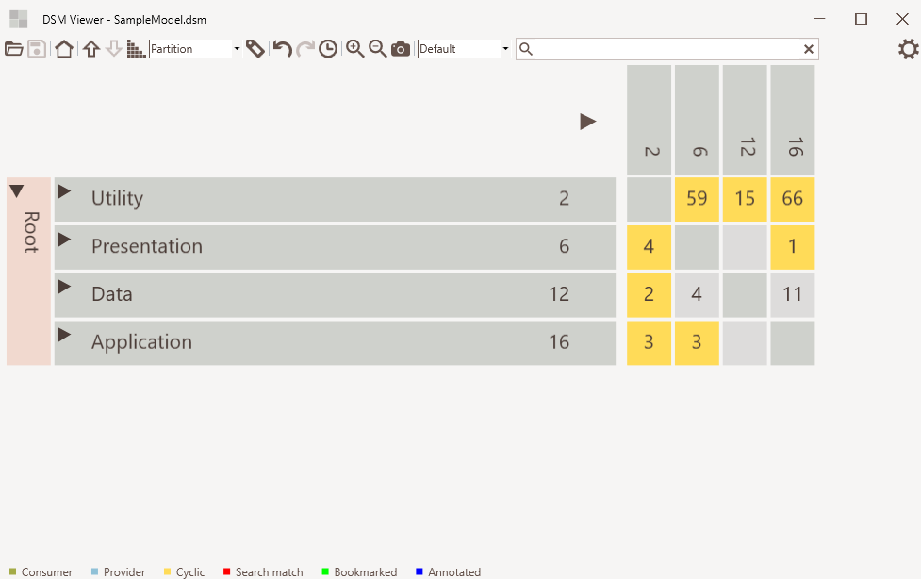
Zoom in/out
Screenshot

Slide 60
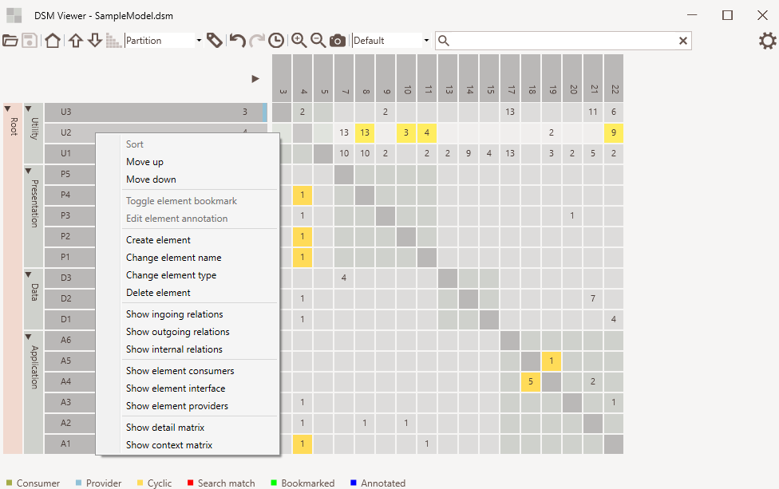
Element context menu

Slide 61
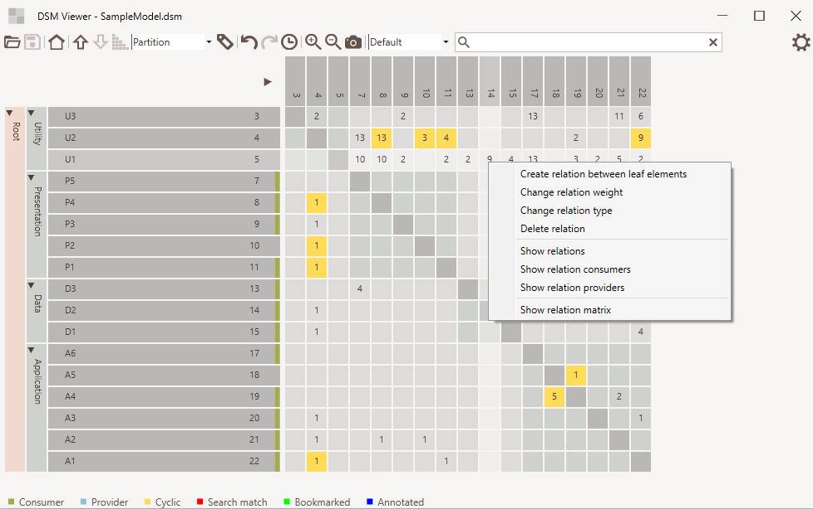
Relation context menu

Slide 62
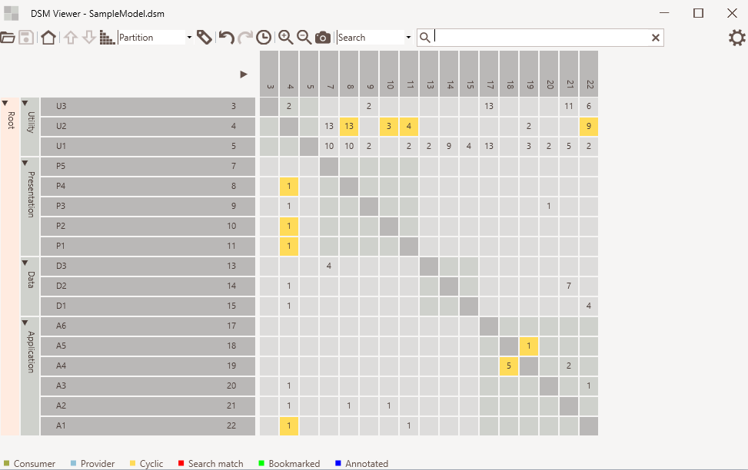
Move up/down
Sort
Undo/redo and history
Move element using drag and drop
Edit relation using cell context menu
Edit element using cell context menu

Slide 63
Lattix

Slide 64
Enterprise Architect

Slide 65
CppDepend

Slide 66
Understand

Slide 67
Structure101

Slide 68
Analysis

Slide 69
DsmSuite

Slide 70
Comparer
Analyzer
Compares
Analyzer
Analyzer
Analyzer
DSI
file
Viewer
DSM
file
Analyzer
Exports
Imports
Visualizes
.Net, Java, C++, Visual Studio and UML
Conforms To
dsi.xsd
Third Party Analyzer

Slide 71
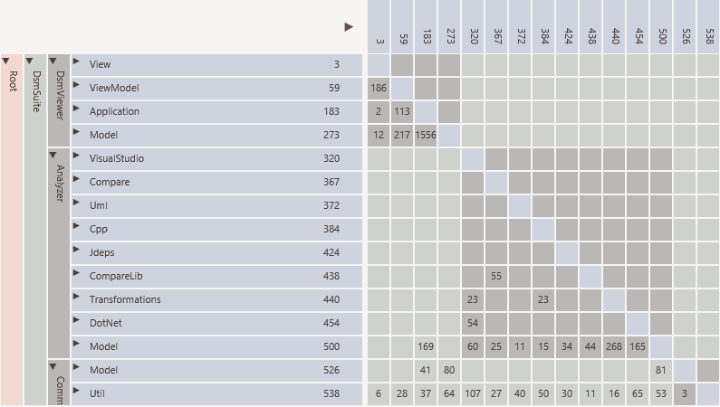

Slide 72
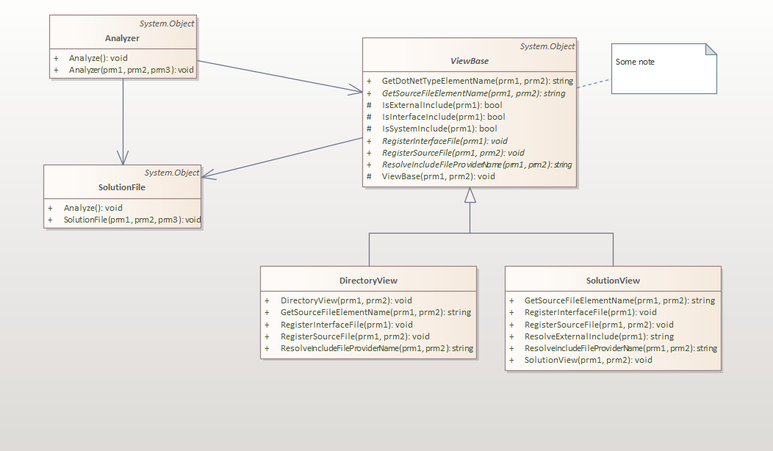

Slide 73
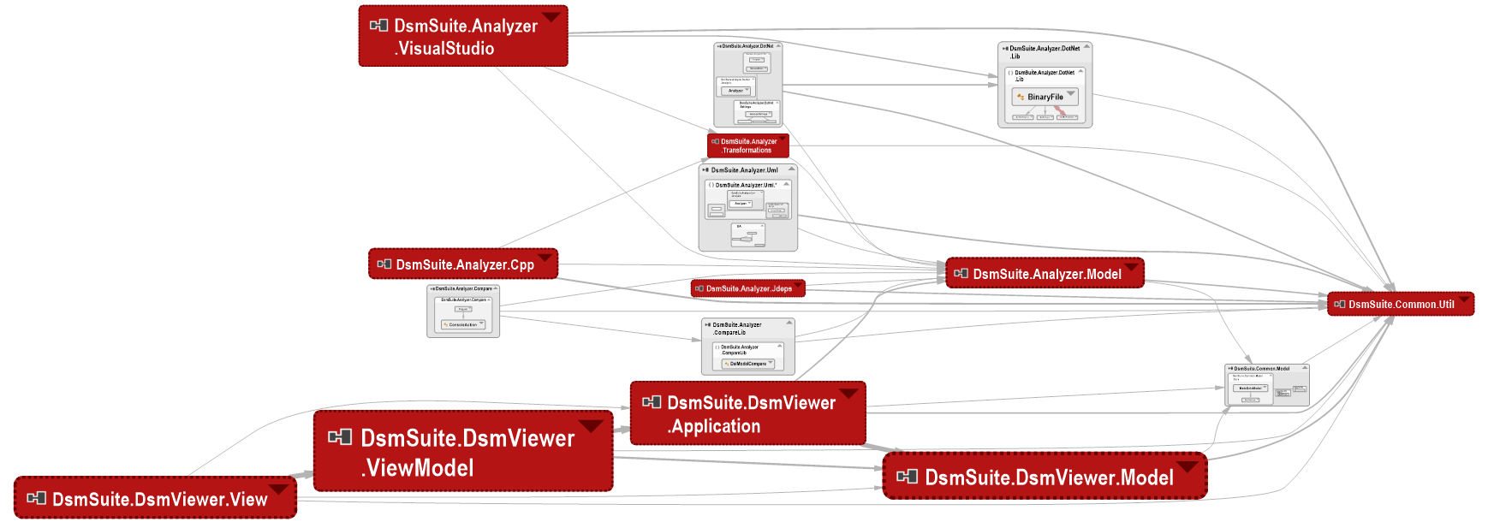

Slide 74
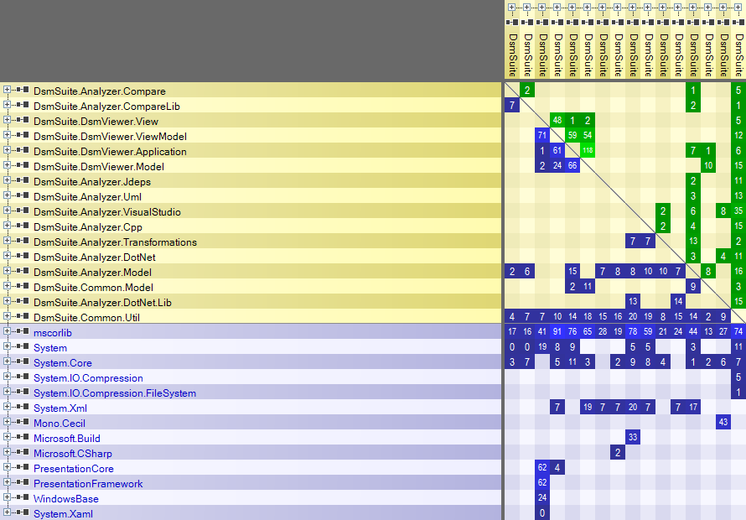

Slide 75
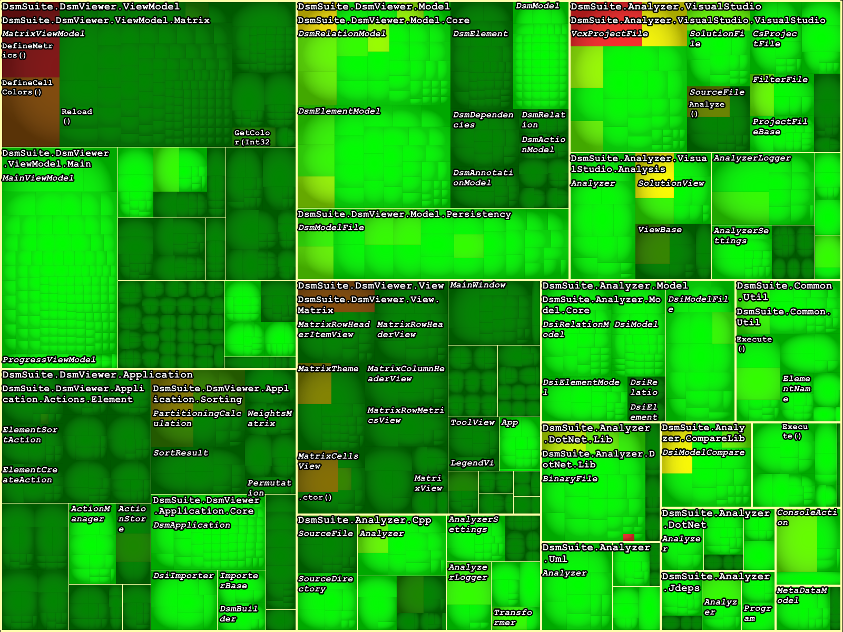

Slide 76
ArgoUml

Slide 77
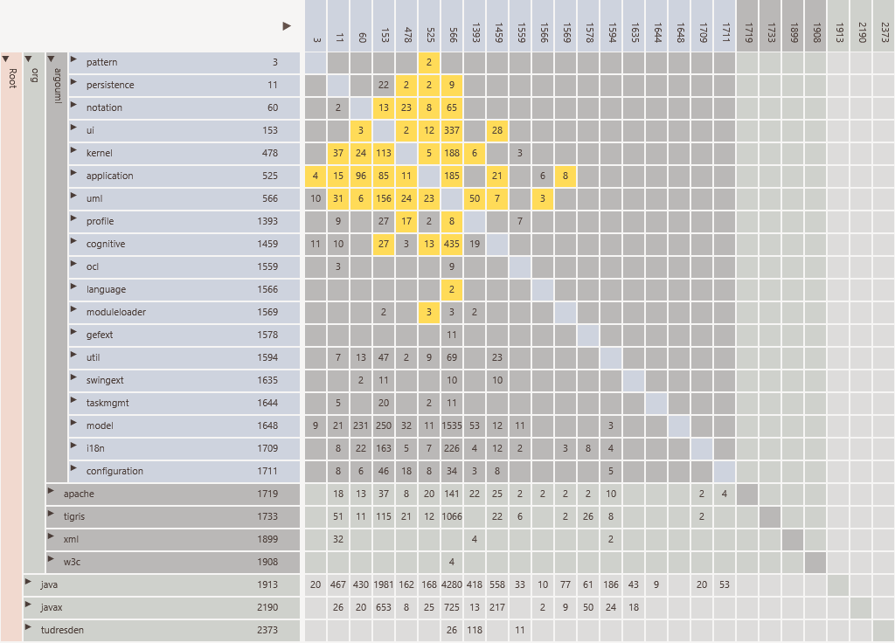

Slide 78
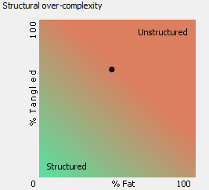
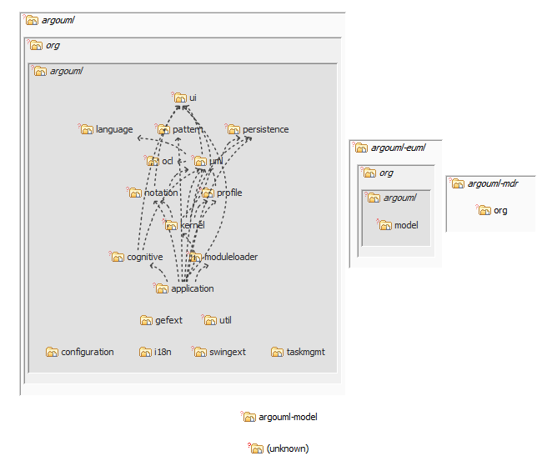

Slide 79
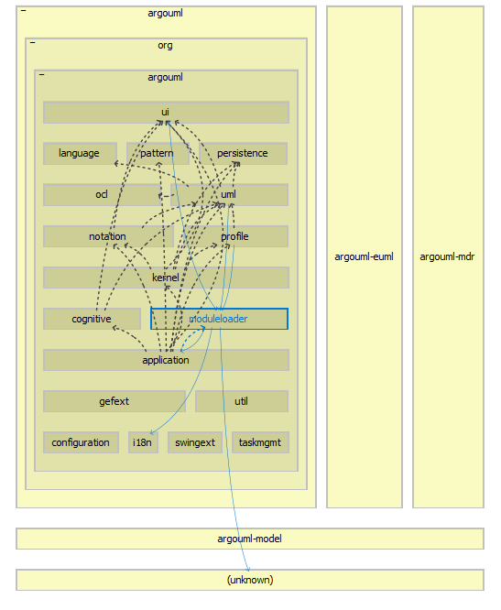

Slide 80
Telegram

Slide 81
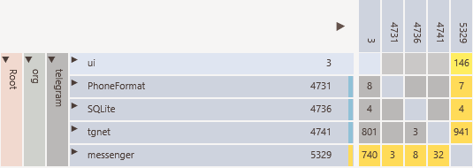

Slide 82
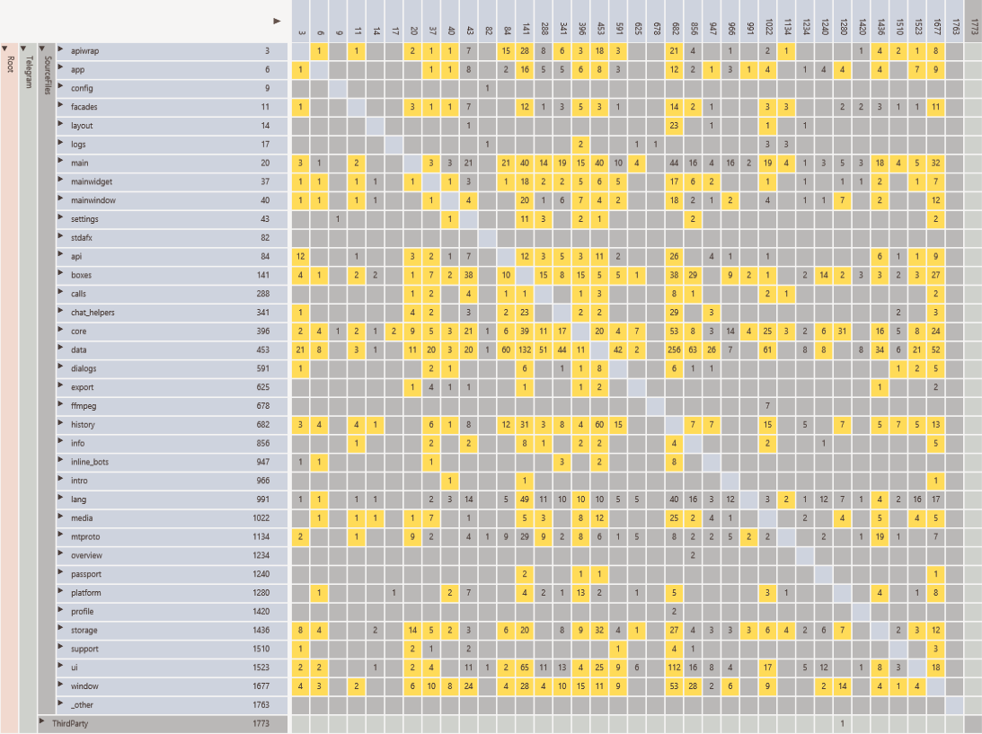

Slide 83
Poco

Slide 84
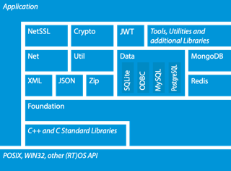

Slide 85
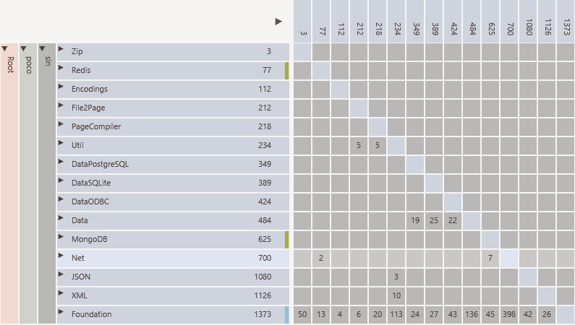

Slide 86
Qt

Slide 87
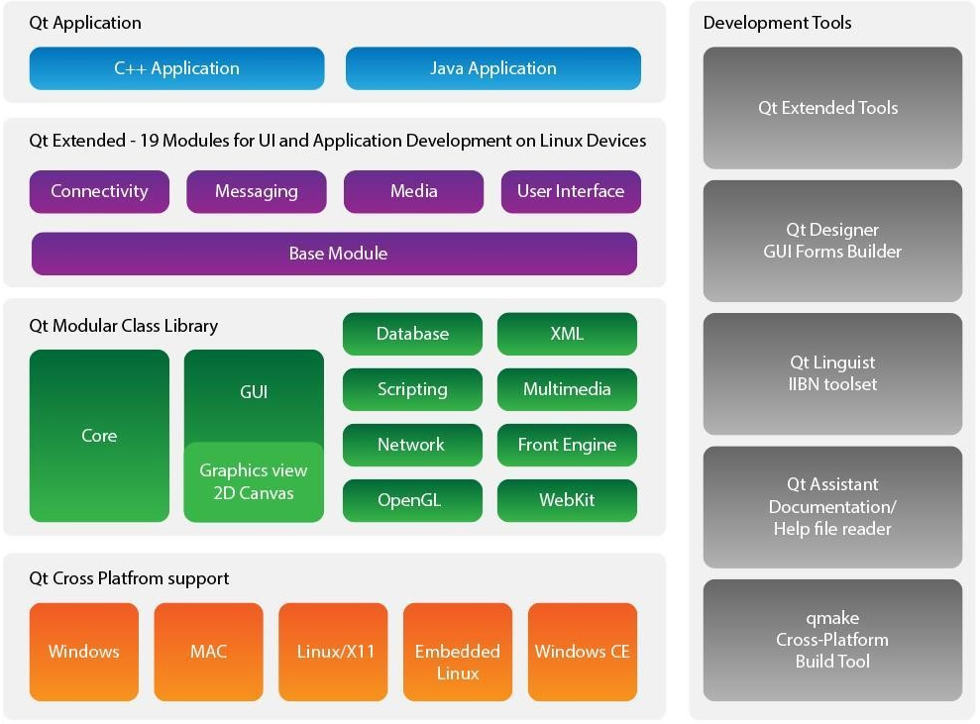

Slide 88
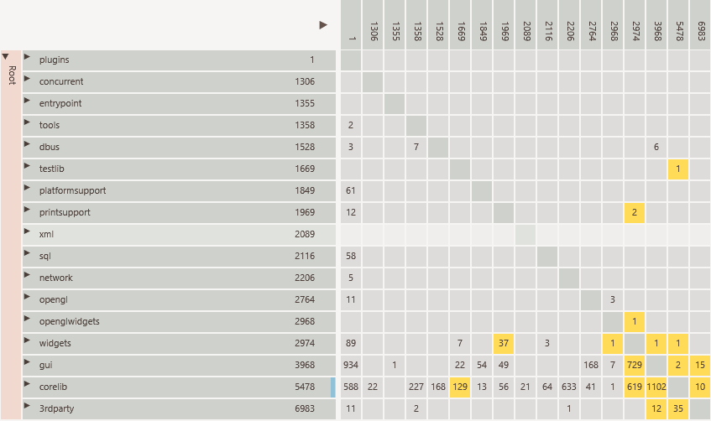

Slide 89
Linux

Slide 90
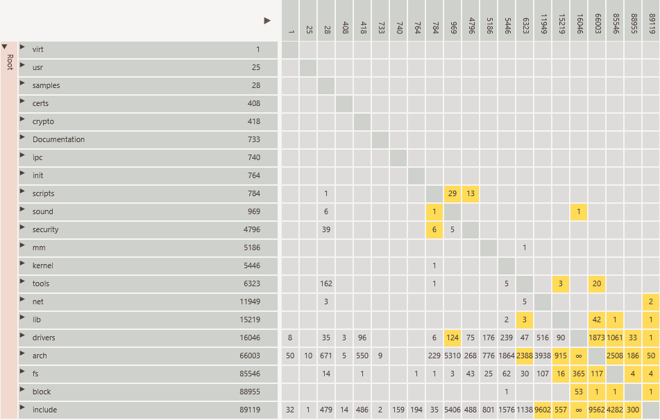

Slide 91
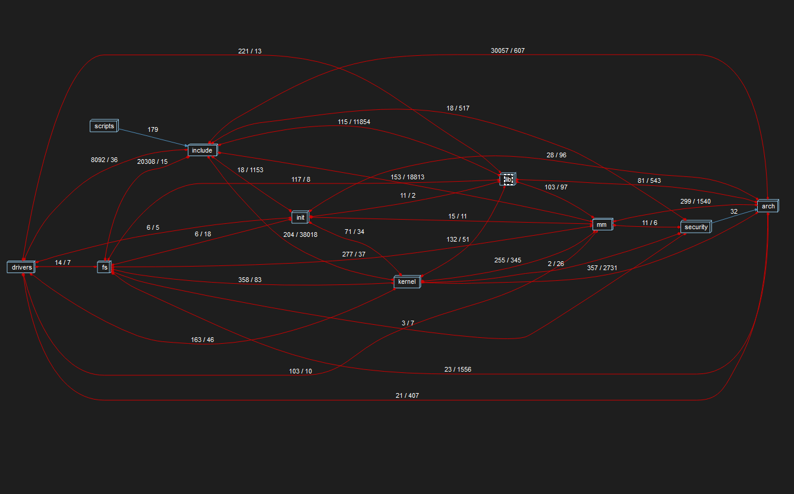

Slide 92
Spring Framework

Slide 93
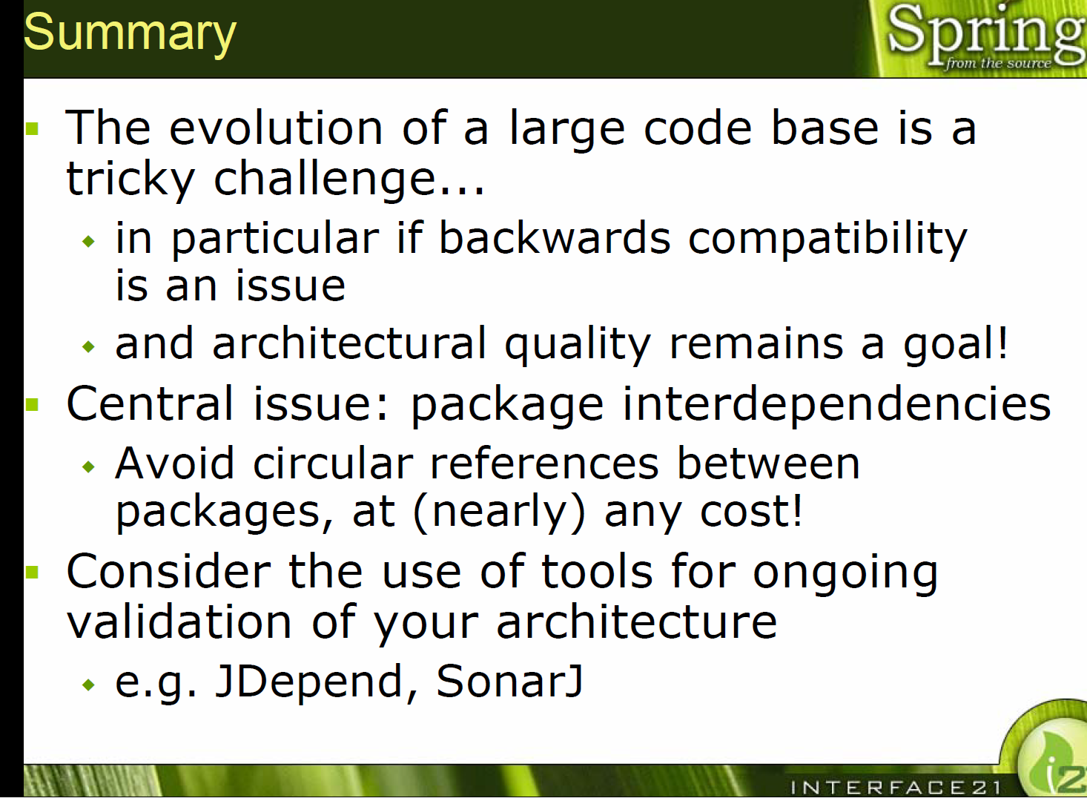
https://res.infoq.com/news/2007/06/large-code-bases/en/resources/code-organization_jho.pdf
https://www.infoq.com/presentations/code-organization-large-projects/

Slide 94
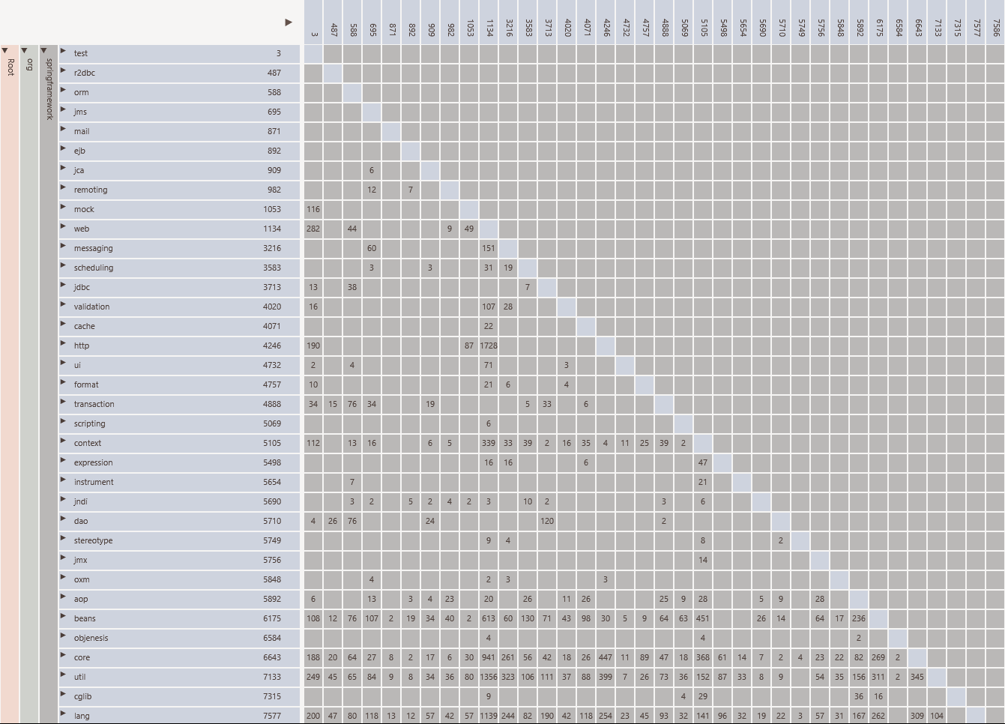

Slide 95
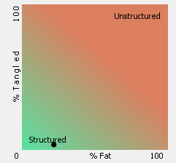
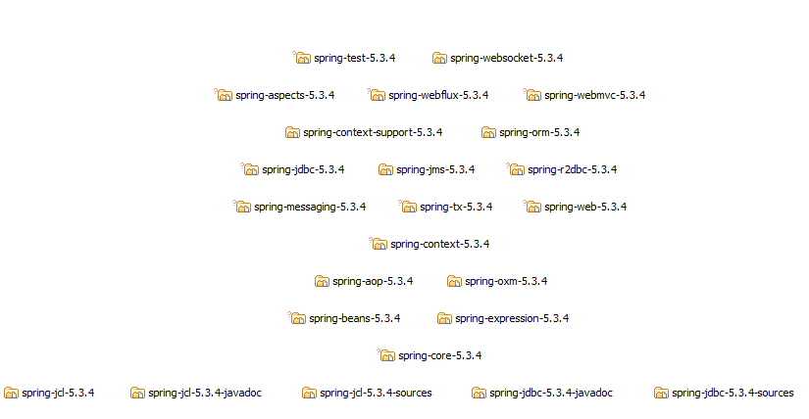

Slide 97
Conclusions

Slide 98
Intro

Slide 99
Intro

Slide 100
Intro

Slide 101
Intro

